Slide 1
CI/CD Assignment
Submitted By :-
Arunesh Jain

Slide 2
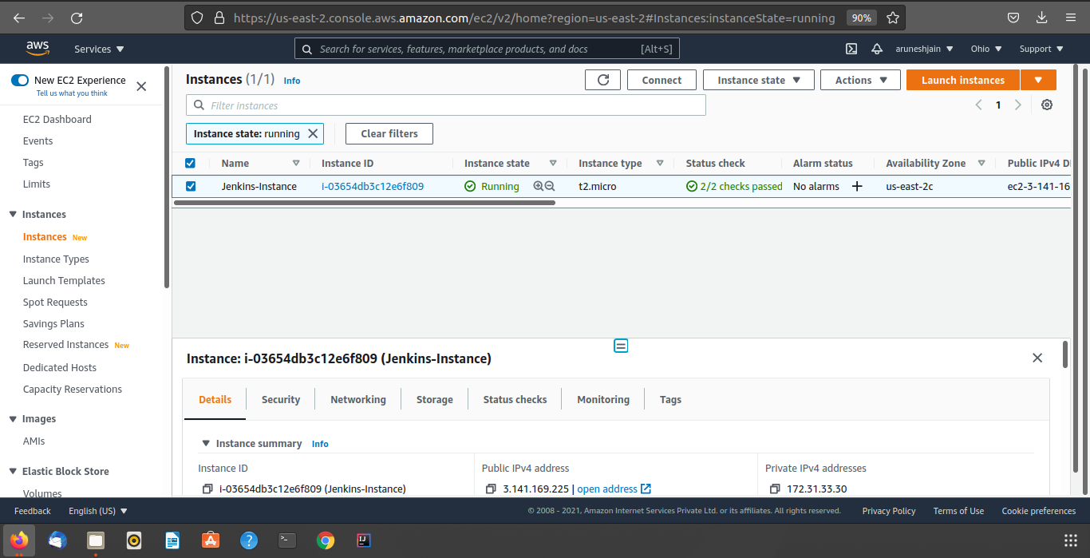
Creating Instance in AWS

Slide 3
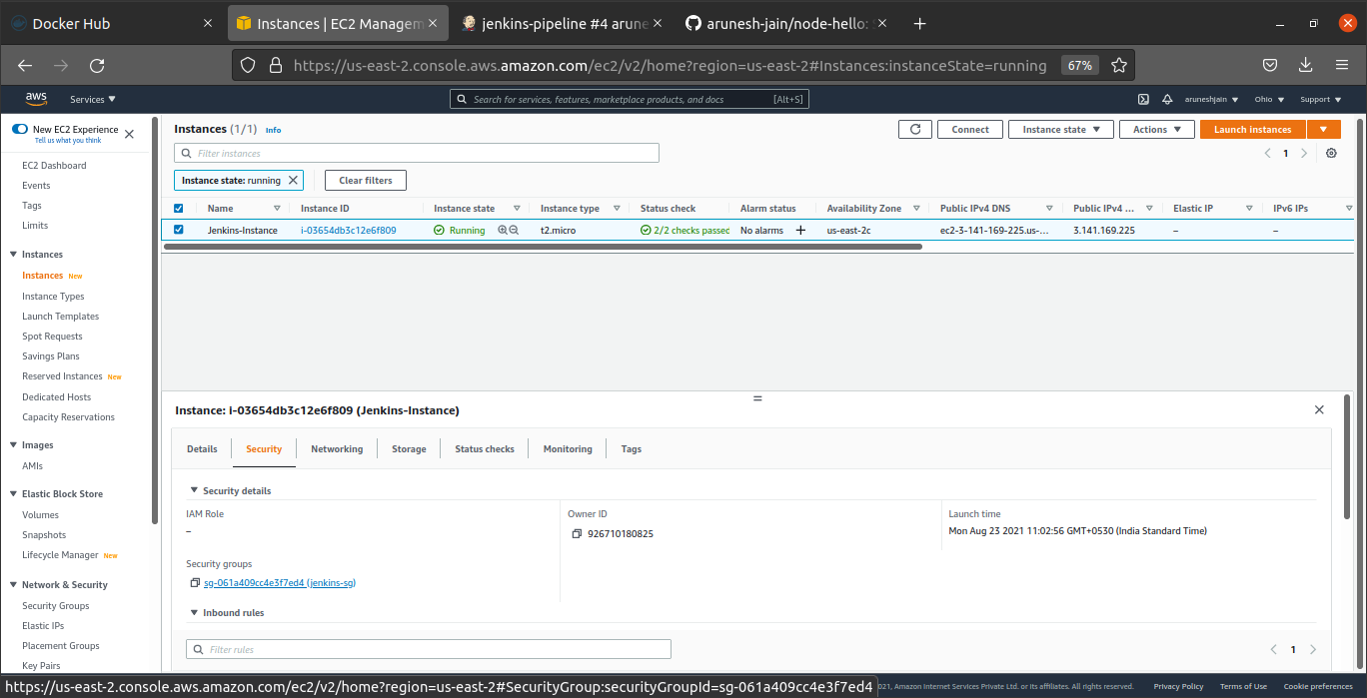
AWS - Editing Security Inbound Rules

Slide 4
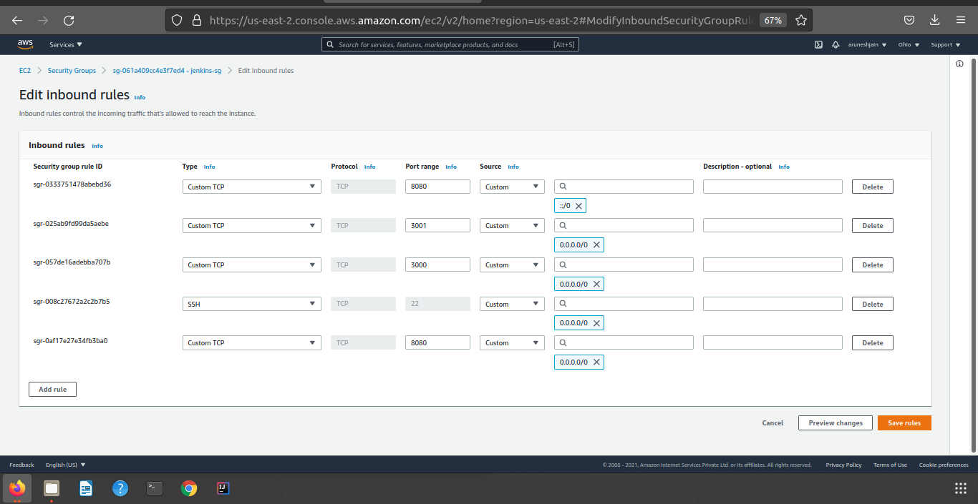
AWS - Setting Security Inbound Rules

Slide 5
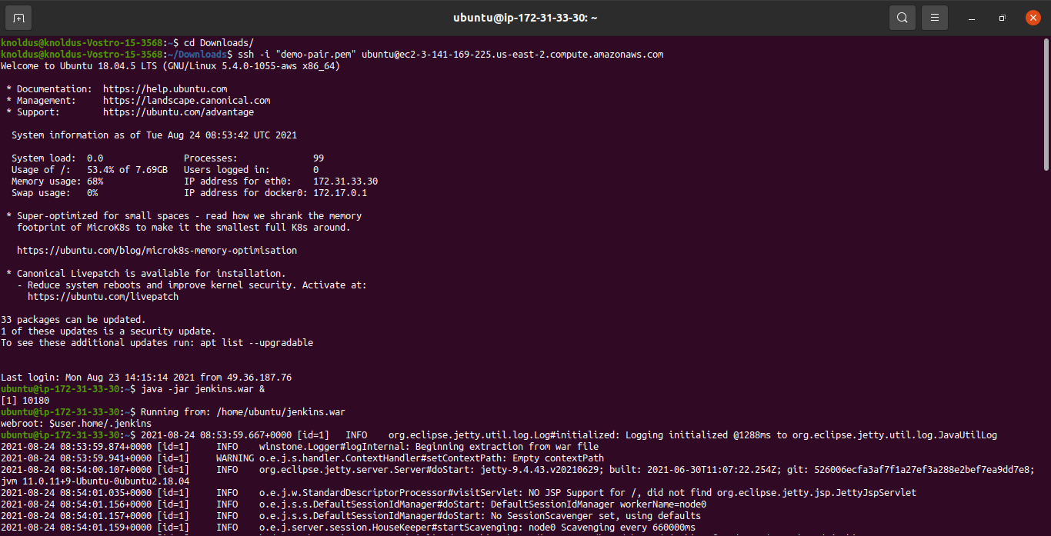
Runnning AWS and Jenkins through Terminal

Slide 6
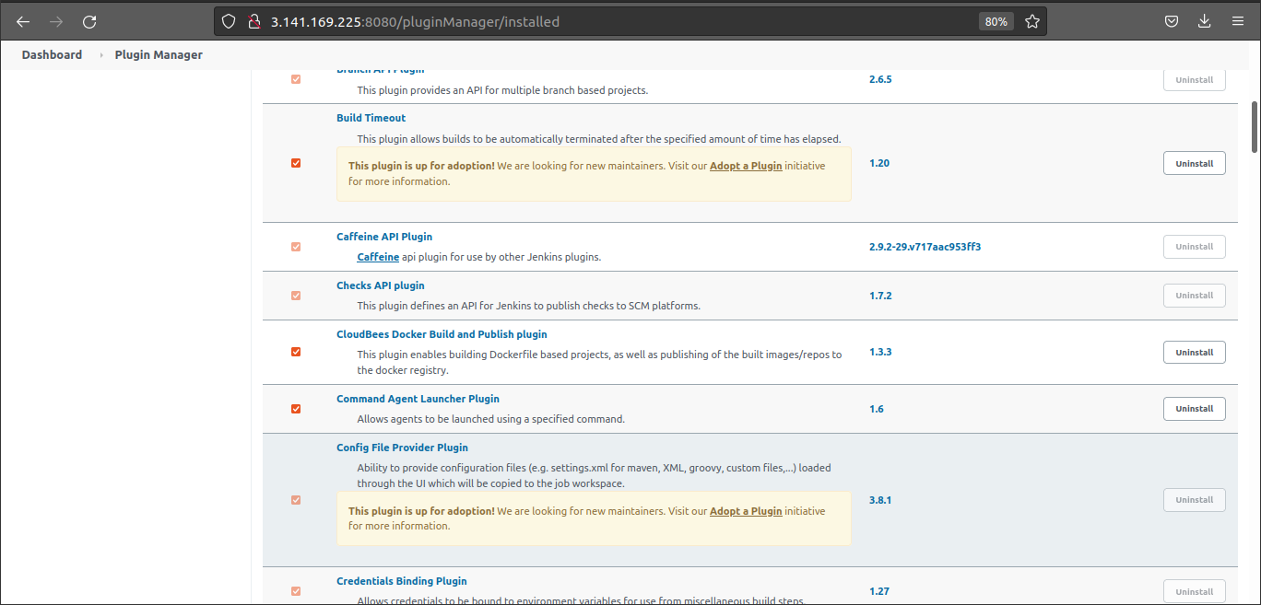
Jenkins – Adding Plugins

Slide 7
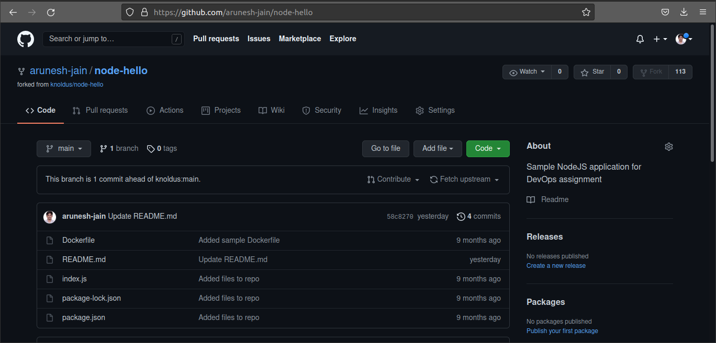
GitHub - Fork node-hello

Slide 8
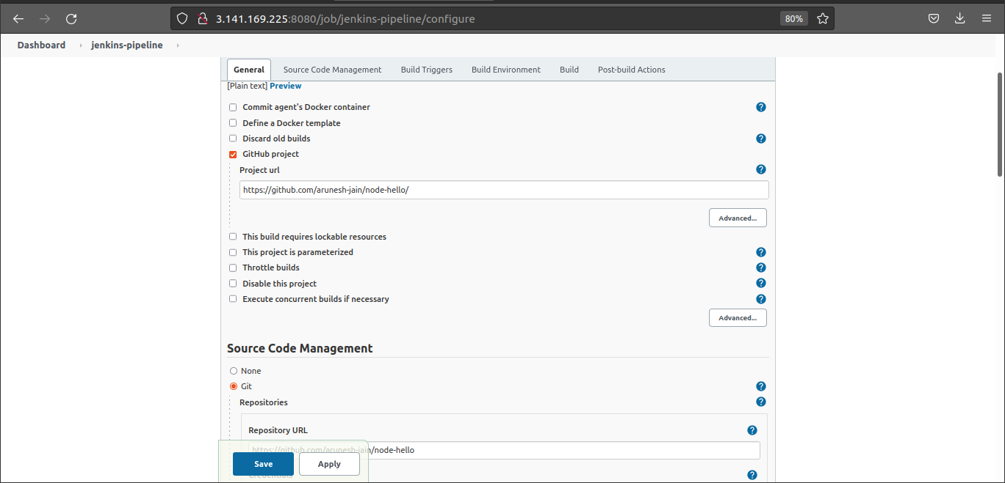
Jenkins – Pipeline General Configurations

Slide 9
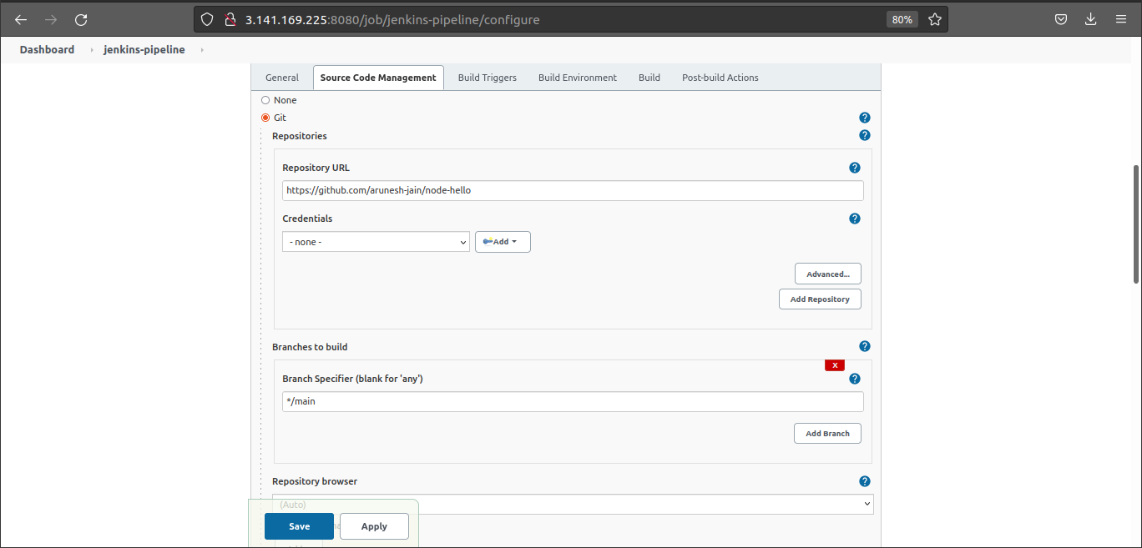
Jenkins – Source Code Configurations

Slide 10
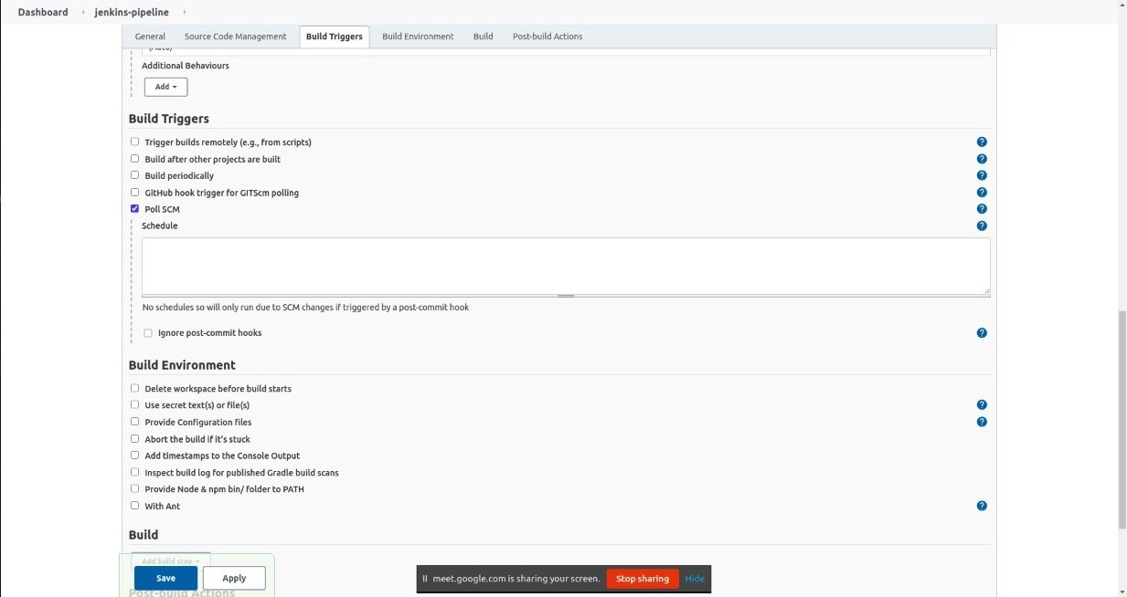
Jenkins – Build Triggers Configuration

Slide 11
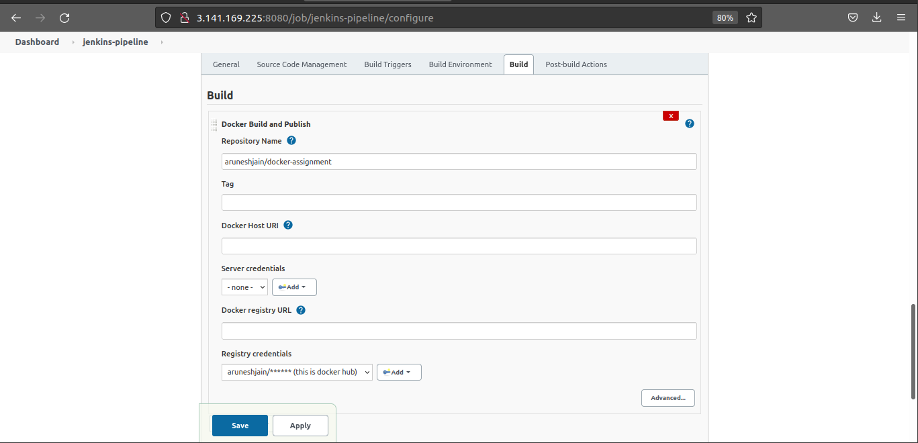
Jenkins – Build Configuration

Slide 12
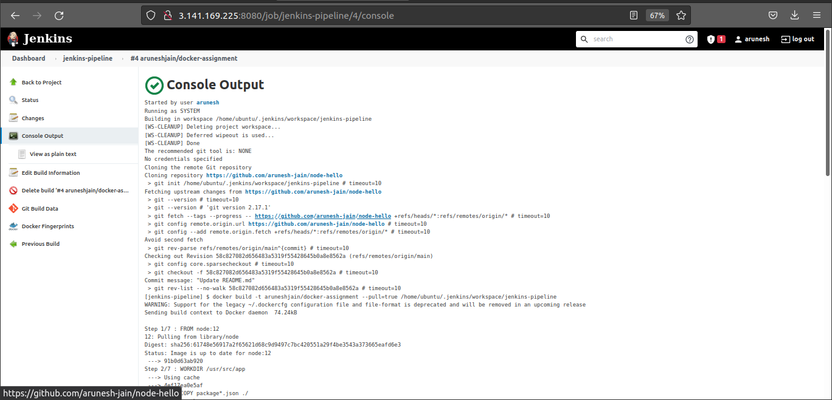
Jenkins – Build Console Output

Slide 13
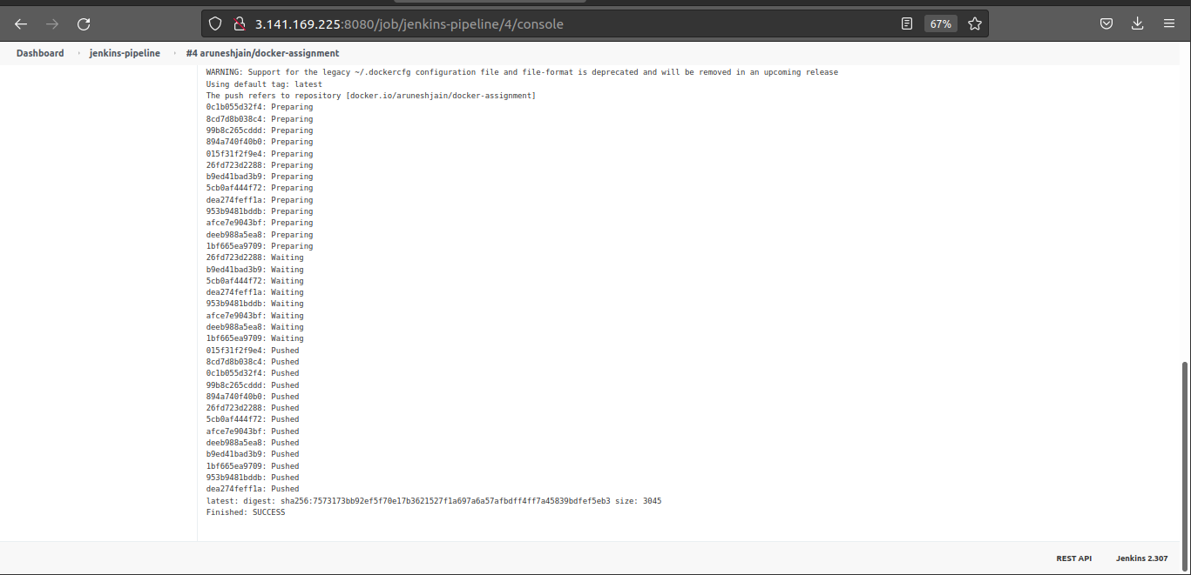
Jenkins - Build Console Output - Success

Slide 14
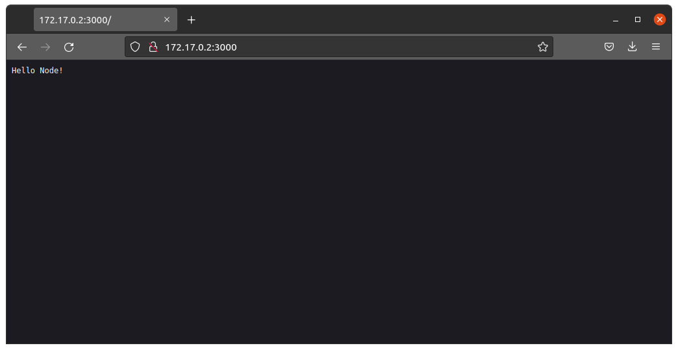
172.17.0.2:3000

Slide 15

172.17.0.2:3001

